Slide 1
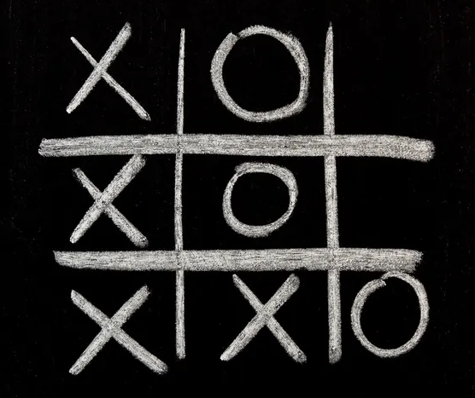
“The Game of Noughts and Crosses”
group 21216
Tatarintsev Vladislav
Makhov Nikolay
Pogibelnaya Olga

Slide 2
Gamepad

Slide 3
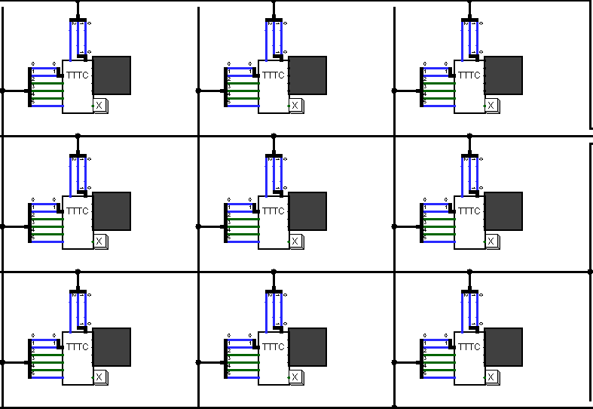
Playing field

Slide 4
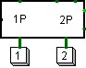
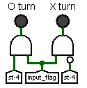
Game mode selection panel
Player move indicators

Slide 5
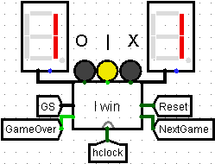
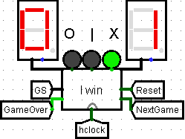
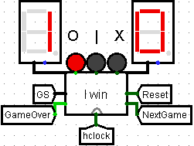
Draw
Crosses win
Noughts win

Slide 6
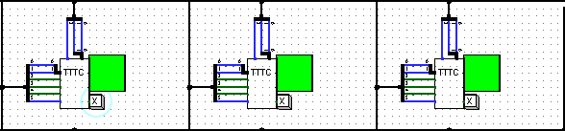


Illuminated row
Button “Reset”
Button “Continue”

Slide 7
Hardware improvements

Slide 8
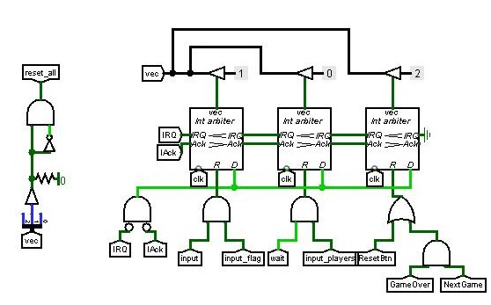
Interrupt arbiters

Slide 9
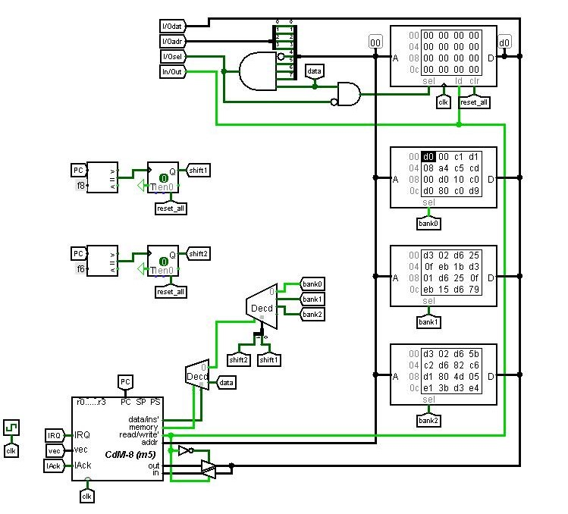
Banks of data

Slide 10
Software

Slide 11
Game mode
for two
checks for the victory of noughts
checks for the victory of crosses
AI
puts the third nought in a row
blocks 2 crosses in a row with a nought
puts a nought in the middle and corners
MAIN
distributes depending on the number of players (1 or 2)
checks for a player's win or draw (if single mode)

Slide 12
We have added the following improvements:
Score
"Continue" button
"Reset" button
A game for two people
Highlighting the winning row
LEDs indicating a whose move

Slide 13
